Slide 1
SMALL BUSINESS
RETIREMENT TEAM
Educating Small Business Owners about
Tax-Free Retirement and Disability Protection

Slide 2
48%
Small business failures due to a critical injury or illness of the business owner

Slide 3
What happens if I get sick or hurt or die?
Business disability insurance is very expensive
Business disability policy only pays monthly amount
Limited period of time that disability will pay
Disability benefits paid may be taxable
...and what happens to my business and family if I die?

Slide 5
How Living Benefits can protect your business

Slide 6
34%
of small business owners don’t have a retirement savings plan
Notes:
June 2017 online survey of 1,960 small business owners conducted by Manta, an online community for small businesses
https://www.manta.com/resources/small-business-trends/small-business-retirement-savings-plan/

Slide 7
Retirement Options and Taxes
TAXED NOW
TAXED LATER
TAX FREE
Real Estate
Mutual Funds
Stocks
Bonds
CDs
Money Market
401(k)
IRA
SEP
403(b) TSA
457
Annuities
Pension
Tax Exempt Bonds
Roth IRA
529 Plans
Cash Value Life Insurance

Slide 8
Conventional Wisdom - Tax Later
TAXED NOW
TAXED LATER
TAX FREE
401(k)
IRA
403(b) TSA 457
Pension
Annuities
Real Estate
Mutual Funds
Stocks
Bonds
CDs
Money Market
Tax Exempt Bonds
Roth IRA
529 Plans
Cash Value Life Insurance

Slide 9
Ted Benna “Father of the 401(k)”
“This monster is out of control...I would blow up the system and restart with something totally different”.
“The tool was never meant to serve as the main means by which workers save for retirement - increasing financial risk for workers along the way”.
SmartMoney.com interview Wall Street Journal interview

Slide 10
Ted Benna “Father of the 401(k)”
I helped open the door for Wall Street to make even more money than they were already making. This is one thing I do regret.
The proliferations of 401(k) plans have exposed workers to big drops in the stock market and high fees from Wall Street money managers
https://www.wsj.com/articles/the-champions-of-the-401-k-lament-the-revolution-they-started-1483382348
https://www.cnbc.com/2017/01/04/a-brief-history-of-the-401k-which-changed-how-americans-retire.html
Notes:
https://www.wsj.com/articles/the-champions-of-the-401-k-lament-the-revolution-they-started-1483382348
https://www.cnbc.com/2017/01/04/a-brief-history-of-the-401k-which-changed-how-americans-retire.html

Slide 11
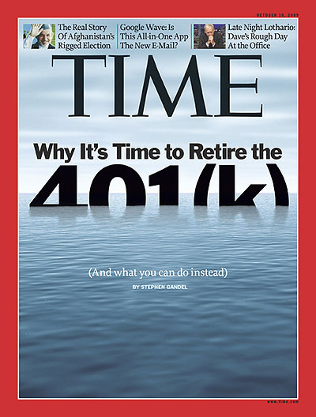

Slide 12
Are taxes really going to be lower when you retire?
Notes:
Are taxes going to be higher when you retire? Probably not.
Tax rates can increase and your higher income will put you in a higher tax bracket. Probably fewer deductions when you retire ( no dependent children, mortgage interest deduction, etc.)

Slide 13
401(k) and IRA is a partnership with the IRS - and the IRS controls the partnership

Slide 14
401(k)/IRA Limitations
IRA annual max contribution $6000/$7000 (55+)
Cannot contribute to IRA over age 70 1/2
401(k) annual max contribution $18,500
401(k) costly/mismatch for small businesses
401(k) has limited investment options
10% penalty to access money before age 59 1/2
Notes:
Solo 401(k)
A solo 401(k), also called an “individual 401(k),” is a great solution for the self-employed as well. The solo 401(k) offers both employee and employer contributions.
The plan is available only to business owners, spouses involved in the business, and partners. Other employees are not allowed to participate.
Employee salary deferrals are allowed, as well as employer profit sharing contributions.
Contribution limit is $18,500 annually with a $6,000 catch-up for those who are 50 or over at any point during the year.
The maximum combined employee contributions plus employer profit sharing contributions cannot exceed $55,000 for 2017, with an extra $6,000 up to $61,000 for those who are 50 or over during the year.
Most major custodians support solo 401(k)s. Investment options are generally the same as available to other investors in brokerage or IRA accounts.
Both salary deferral and employer profit sharing contributions can generally be made until the date your return is filed, including extensions.
Loans (up to 50% of balance) and Roth option are permitted.
There are minimal governmental filing requirements that generally don’t kick in until the plan balance exceeds $150,000.
A simplified employee plan (SEP) IRA is a type of IRA that works well for the self-employed or the small business owner. If you have employees, they can make contributions. But this can be an expensive proposition, since contributions for employees must match the percentage of the salary that the owner makes for themselves. Not best option for business with employees
Contributions are made entirely by the business. There are no employee contributions.
Contributions are a business expense.
Contributions can be made up to 25% of compensation. For those who are sole proprietors, this might actually end up as 20% of self-employment income due to the way the calculation flows through Schedule C.
The maximum contribution for calendar year 2017 is $55,000.
Investment choices are generally the same as for a regular IRA account.
A SEP IRA account can be opened and funded up until the date your tax return is filed, including extensions for the prior year.
There are no loans available from a SEP IRA.
There is no Roth option available.

Slide 15
Taxable Deferred Still Taxed
Will tax rate be higher when you retire?
Tax is paid on ALL money that you take out of a Traditional IRA or 401(k)
Required Minimum Distributions (RMD) pay taxes on money that you are required to take out every year, even if you don’t need the money
50% penalty if you calculate RMD incorrectly

Slide 16
How Fees Impact Your Retirement
Management fees of 401(K), Mutual Funds (IRA), Stock Market average 1%-3% a year
For Example: 10% gain - 2% fees = 8% real gain
10% loss + 2% fees = 12% real loss
Notes:
How to handle objection about insurance agent commissions:
Would you rather pay a realtor a one time 6% (3% buyer/3% seller) commission to sell your home or pay 1%-3% of the increasing value of the home every year. And by the way, the insurance company pays the agent commission, not your as a policy holder.

Slide 17
Wall Street is the only one guaranteed to make money from your IRA / 401(k) while you take all the risk!

Slide 18
TAX-FREE OPTIONS
TAX FREE
TAXED NOW
TAXED LATER
Tax Exempt Bonds
Roth IRA
529 Plans
Cash Value Life Insurance
Real Estate
Mutual Funds
Stocks
Bonds
CDs
Money Market
Tax Deferred
Retirement Plans
401(k)
Annuities
SEP
Deferred Comp

Slide 19
Warren Buffett - Rules of Investing
Rule #1 Never lose money
Rule #2 Never forget rule #1
Personal net worth $84B 2017, 3rd Richest in world

Slide 20
Investment Gain Only With No Loss
Year Gain/Loss Amount 1 10% $100 $1,100 2 -10% $110 $990 3 10% $99 $1,089 4 -10% $108 $980.10 5 10% $98.01 $1,078.11 6 -10% $107.81 $970.30 7 10% $97.03 $1,067.33 8 -10% $106.73 $960.60 9 10% $96.06 $1,056.66 10 -10% $105.66 $950.99
Year Gain/Loss Amount 1 10% $100 $1,100 2 0% $0 $1,100 3 10% $110 $1,210 4 0% $0 $1,210 5 10% $121 $1,331 6 0% $0 $1,331 7 10% $133.10 $1,464.10 8 0% $0 $1,464.10 9 10% $146.41 $1,610.51 10 0% $0 $1,610.51

Slide 21
Insurance Industry Indexing

Slide 22
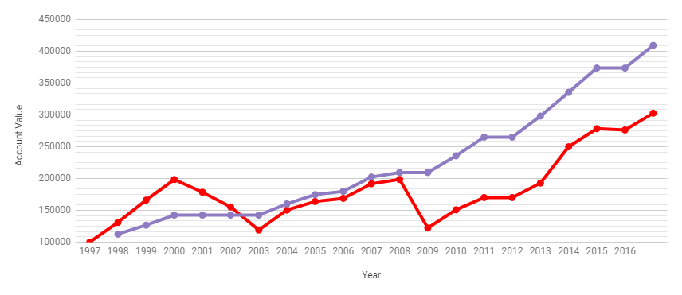
$402,337
Actual Performance 1997-2016
$402,337 - Index Universal Life $302,679 - S&P 500 Stock Market Index
$302,679
Notes:
Actual performance of National Life Group FlexLife II with S&P 100% Participation with Cap Option Strategy 1

Slide 23
Ed Slott - Life Insurance and Beyond

Slide 24
IRS Tax Code for Life Insurance
101(a) - Death benefit is income tax-free
72(e) - Earned interest viewed as increase in death benefit and not taxable
7702 - Allowed to reduce death benefit by taking cash out of policy tax-free

Slide 25
Tax Free Retirement
Access cash anytime for any purpose (college education, home remodel, new car, etc.) without penalties, tax, or RMD
Cash plus the tax-free death benefit paid to family
Lifetime income options - never outlive your money

Slide 26
Business Owner Advantages
Policy premiums are business deduction
Use policy cash value loans to fund business growth, buy equipment, etc.
Flexible premiums - min/max carry over year to year
Buy/sell agreements

Slide 27
Business Owner Advantages
Protection from legal judgement
Tax-free death benefit for family legacy
Bypass estate and estate taxes

Slide 28
What’s The Next Step?
Typical budget is 10% of monthly income
Any medical or health issues?
Review illustration and options available
Submit request for coverage to qualify

Slide 29
SEP-IRA
Advantages over Traditional IRA - Higher contributions (0-25% income, max $55,000)
Disadvantages - Taxed on distributions, 10% early withdrawal penalty, Required Minimum Distributions (RMD) - Business must contribute same percentage to all employees - No loans available, No ROTH option Costly for small business with employees

Slide 30
Sorry About That Whole 401(k) Mess
In retirement planning, as in electrical wiring, not everyone is cut out to be a do it yourselfer... Investment fees chip away at account owners’ returns...The typical American worker is badly underprepared for old age...By now, it shouldn’t take a social visionary to recognize that 401(k)s aren’t enough. Indeed millions of families already see that all too clearly.
“Sorry about that whole 401(k) mess”, Dante Ramos, Boston Globe 1/2/2017

