Slide 1
Ameritas
Access Whole Life
DF4L Focus
Notes:
This presentation will cover the Ameritas Access WL product and why specifically it is being used for Debt Free for Life focus. You will find helpful notes in the sections below each slide.
*This presentation is NOT for use with clients. It is to be used only for agent training purposes*

Slide 2
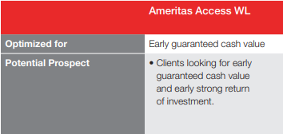
Access WL – Product Details
Premiums are level, guaranteed and payable every year *Client can short-pay if they choose
Guaranteed Contract Rate: 3%
Dividends eligible on product
18 Living Benefit Triggers
FPUR – Flexible Paid-Up Rider *Offers the strongest paid-up additions out of all Ameritas WL products
Notes:
The Access WL product is optimized for Early Guaranteed Cash Value. The potential prospect this product is designed for is clients looking for early guaranteed CV and early strong return of investment.
On the Access WL – premiums are payable every year to age 75, or for 25 years, whichever comes later in the client’s life. On all cases, we are able to design for premiums to be paid for a shorter amount of time, such as 10 years. (Short-pay design will often be how we set these policies up for debt elimination program).
Guaranteed Contract Rate is the guaranteed return on the client’s $ - or in a sense – the “floor” on the product. Access WL minimum guarantee is 3%.
Ameritas is a mutual company (owned by its policyholders) – by being a mutual company, we offer dividends on WL products which will help build your client’s cash value even further.
18 Living benefit triggers if your client were to get sick or come down with an illness early in life, a portion of the death benefit would be paid out early to them.
To maximize the early cash value potential for your client, we will design plans and engage the Flexible Paid-Up Rider (FPUR) that is available. This will maximize paid up additions and purchase additional death benefit, which also leads to growth in cash value.

Slide 3
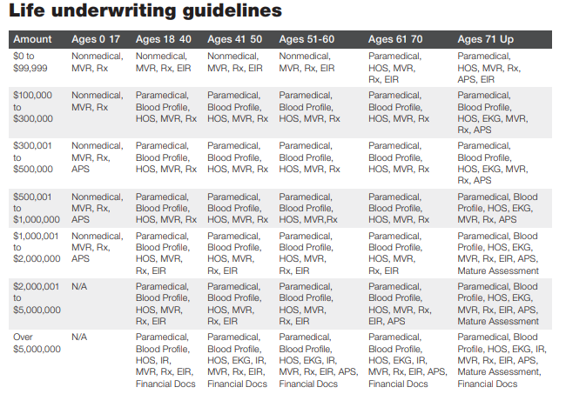
Underwriting on Access WL
$100,000+ may require exam for your client
Accelerated UW Option
18-60 years old
$100k-$1 million
Select “yes” for accelerated UW in eApply
UW does initial review – will let you know if paramed is needed
Notes:
A paramed exam may be required on this product for your client.
If your clients is 18-60 years old, applying for $100,000 - $1 million, they can apply for Accelerated UW. You will need to apply for Accelerated UW in eApply (found on the Ameritas website).
If the client qualifies for Accelerated UW, the paramed exam will be waived. If they do not qualify, a paramed will be ordered as part of the outstanding requirements on the case. The agent will be notified if an exam is needed.

Slide 4
Talk to your clients about living benefits
Show how living benefits are paid:
25% Critical
50% Chronic
75% Terminal
Acceleration Amount is a dollar-for-dollar reduction of Face Amount
Unique to Ameritas
Notes:
18 living benefit triggers on the Access WL product
If a living benefit is triggered and a claim is paid out, the “Lien Approach” is used to pay out those living benefits. -Lien approach: pre-determined % of what the payout will be. Clients also do not forfeit the remainder of their policy benefits by accelerating early. It is a dollar for dollar reduction of the face amount. The lien approach also allows your client to use their policy again for living benefits or death benefit. The cash accumulation in the plan is also able to continue to grow cash value for retirement or debt elimination purposes.

Slide 5
18 Living Benefits triggers
Critical (15)
Chronic (2)
End-Stage Renal Failure
Invasive/Metastatic Cancer
Stroke (30 days)
Major Heart Attack
Major Organ Transplant
ALS (i.e., Lou Gehrig's Disease)
Blindness due to Diabetes
Aplastic Anemia
Aortic Aneurysm
Heart Valve Replacement
Paralysis of 2 or more limbs (90 days)
Major Burns
Coma (96 hours)
Benign Brain Tumor
Coronary Artery Bypass Graft Surgery
Severe cognitive impairment
2/6 ADL’s
(90 days)
Terminal (1)
12 months to live or less
Notes:
Clients will either receive all living benefits or NONE of the living benefits.
Table ‘D’ and better get all 18 living benefit triggers
No in-force waiting period for any of the living benefits except the 4 mentioned above.

Slide 6
Paid-Up Additions (FPUR)
Allows client to purchase additional amounts of life insurance
Flexibility allows client to choose when & how much paid-up insurance they buy
Base Premium vs FPUR Premium (overfunding)
FPUR Premium → Helps your client to build more cash value and earn more dividends
Notes:
Including FPUR (flexible paid-up rider) on Access WL plan will automatically include paid-up additions.
Paid up additions allow client to purchase additional amounts of life insurance which also leads to helping cash value grow more rapidly. The policy will purchase additional amounts of insurance automatically when this design is used. There are no follow up steps the agent or client need to take when designing the plan this way.
The FPUR portion of premium is flexible – clients can decide when how much to pay into this portion of premium *For debt elimination purposes and building these plans with the most efficiency, clients will state a specific premium amount per month/per year, and stick to that plan, paying the full base premium & FPUR premium*
By maxing out FPUR premium, client allows their policy to build more cash value and earn more dividends which will compound indefinitely over time.

Slide 7
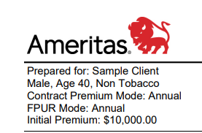
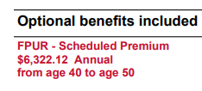
Debt Elimination & Paid-Up Additions (FPUR)
Optimal Plan Design: “Minimum Non-Mec” -Minimizes death benefit -Maximizes cash value growth
Higher Cash Value Growth = Faster Debt Elimination
Total Premium: $10,000/year
Base Premium: $3,677.88
FPUR Premium: $6,322.12
*overfunded portion, helping to build cash value faster
Notes:
Best strategy for debt elimination on Access WL: Set up ‘Plan Design’ as MINIMUM NON-MEC This will allow the illustration software to automatically calculate for us how much premium goes to FPUR premium vs. Base Premium, given ‘x’ amount of premium. It will also keep the policy non-mec which helps your client to avoid tax consequences in retirement.
Example: $10,000/year premium → $6,322.12 allocated towards FPUR… $3,677.88 allocated towards Base Premium.
Commissions: Base premium on a WL plan is like Target premium on an IUL… Base Premium will be what the agent’s commission is majority based on. The FPUR premium, the agent will also receive a small commission on that portion.
*On same $10,000 premium on FLX IUL – only $2,834 is the overfunded excess premium on this same example of $10,000 premium. This tells us that the Access WL allows a much higher portion of overfunded premium to go towards the plan & cash accumulation, when compared to the $6,322.12 FPUR premium listed above on Access WL.

Slide 8
Loans on Whole Life
Loans on WL – either used as Direct Recognition or Non-Direct Recognition
Fixed Loans: Current rate 4% (4% max) -Direct Recognition: Dividends are impacted by loan
Variable Loans: Current rate 4% (Maximum rate varies)
-Non-Direct Recognition: Dividends are NOT impacted by loan
Variable Loan is recommended in most cases
Notes:
Fixed loans use direct recognition, meaning the policy DIRECTLY recognizes the money is missing from the account value, and that portion of loan money is not accumulating dividends or interest.
Variable loans use non-direct recognition, meaning the policy does NOT directly recognize the money is missing from the account value. Dividends and account value would continue to accumulate at interest as if the loan was never taken in the first place. (Preferrable for client’s $$ and debt elimination plan)
There is no maximum on variable loans since it is tied to Moody’s Corporate Bond Yield Average – for more information, please refer to the Access WL Agent Guide.
A fixed loan may be a better option if client wants certainty of having same interest rate for entirety of borrowing period… this also leads to predictable payments for the client if they plan to pay the loan back.
If variable loan rate is extremely high, a fixed loan may also be a better option.

Slide 9
Policy Loans Continued…
Loan Repayments can be made at any time.
Changing loan types is allowed -Can NOT change during 12-month period loan is taken or the date loan type is changed
*Policy loans are available the 1st year when using FPUR*
Notes:
Clients do not have to pay back policy loans but if they choose to do so, they can repay at any time.
Loan repayments: Clients MUST make it known ‘x’ amount of premium is being used for loan repayment, or Ameritas will use it as premium $ to be applied to the plan.
Changing loan types – entire loan balance must be exchanged. New loan will be for same amount with new rate %

Slide 10
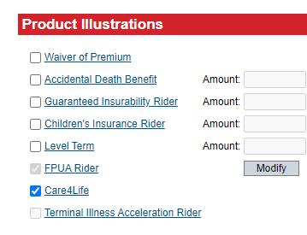
Optional Riders on Access WL
Additional Riders have an extra cost
Care4Life = Living Benefits (free)
FPUA Rider – automatically selected → “Min-Non MEC”
Notes:
Care4Life is included automatically when your client is approved table ‘D’ or better.
FPUA rider is also automatically selected since the “Minimum Non-Mec’ plan design will automatically calculate for us what portion of premium needs to go into this.
Waiver of Premium – will waive the BASE premium if client becomes disabled and can no longer work
Accidental DB Rider – if the insured dies due to an accident, an additional lump sum benefit would pay out to the beneficiary.
Guaranteed Insurability Rider – allows client to increase base coverage without having to go back through UW.
Children’s rider - $25,000 of death benefit protection for each kid in the family
Level Term – additional death benefit protection for up to 10-30 years. This rider is also convertible to permanent coverage.

Slide 11
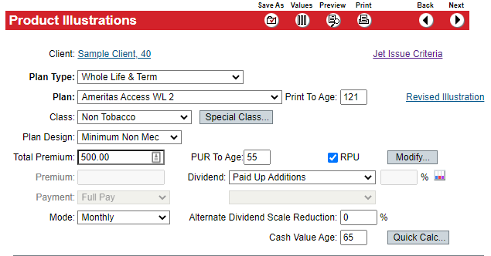
Setting up the Quote
Plan Design: Min-Non Mec
*Input premium amount*
PUR = Flexible Paid-Up Rider (overfunded premium)
RPU = Reduce Paid-Up (Base premium)
*Choose how long to pay premium*
Dividend: ALWAYS select Paid Up Additions
Notes:
Setting up the Quote when focus is for Debt Elimination/Maximum Early Cash Value.
Plan Design – select “Minimum Non-MEC”
Input Premium Amount and Mode of premium payments
PUR To Age & RPU – choose what age you want premium payments to go to. These ages should match each other in most case designs.
Dividend – always choose “Paid Up Additions” (This is the default option selected for you)
If there are no other changes to make, click “Preview” in the top red bar and your illustration will pull up on the screen.

Slide 12
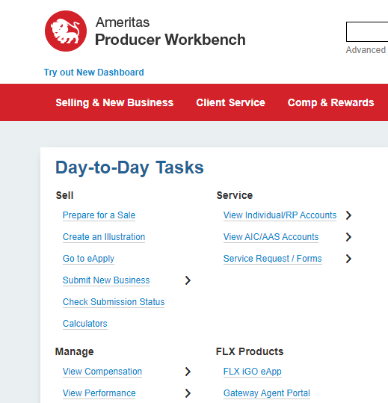
Tools for Access WL
Quotes/Illustrations
eApp for Access WL (and all Non-FLX)
View Pending Cases & Status
*DF4L Software provided by Equis
Notes:
Create an Illustration – for any illustrations you need on any Ameritas product (including Access WL)
Go to eApply – The eApp system for Access WL and any non-FLX product at Ameritas
Check Submission Status – where to view your pending non-FLX cases and outstanding requirements
The Debt Free 4 Life Software will be provided by your Equis team – you will not see any information on the Ameritas website related to this.

Slide 13
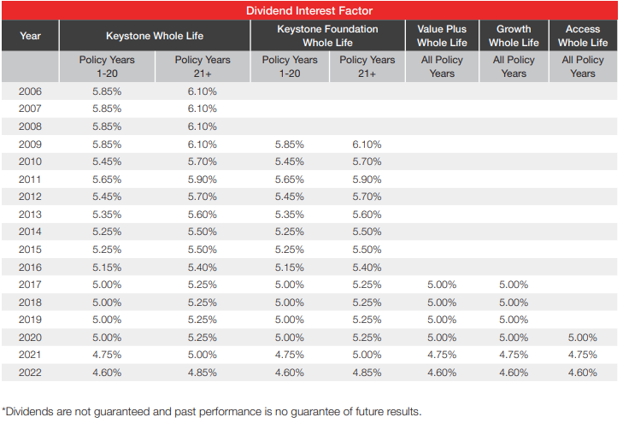
Ameritas has paid dividends consistently, even during periods of declining interest rates.
Declared Interest Rate for 2022: 4.60%
Notes:
With the way we are structuring these policies in Debt Free 4 Life, dividends will be used to build cash value and increase the policy’s death benefit for your clients.
Dividends are not guaranteed.
Dividends will be paid out when company performance is favorable for Ameritas.

Slide 14
For Help & Other Questions…
Contact Us!
Sales Desk: 800-390-2361, Opt 1, Opt 1
Email: IDC.Sales@Ameritas.com
Other References
Non-FLX UW Guide: LI 1333 LG
Access WL Marketing Guide: LI 2351
Access WL Product Guide: LI 2538
More About Flexible Paid-Up Rider: LI 2377
Ameritas Dividend History Report: LI 1941
Notes:
If you need help or have any questions at all related to the Access WL product or working with Ameritas, please give us a call at 800-390-2361.
*This presentation is NOT for use with clients. It is to be used only for agent training purposes*

